Slide 1
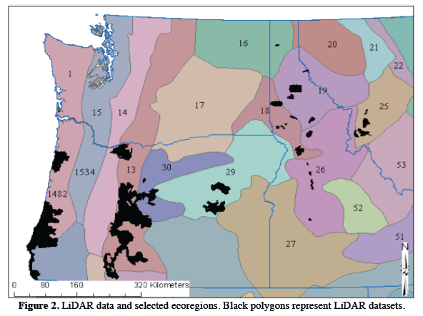
Prototyping a methodology to develop regional-scale forest aboveground biomass carbon maps predicted from Landsat time series, trained from field and lidar data collections, and independently validated with FIA data
Andrew Hudak, Nick Crookston, Chris Woodall¹
Michael Falkowski, Patrick Fekety²
Robert Kennedy³
Alistair Smith⁴
Nancy Glenn⁵
¹US Forest Service
²University of Minnesota
³Oregon State University
⁴University of Idaho
⁵Boise State University
14-CMS14-0026

Slide 2
Reference Plot Database
(This “living” database will grow as more reference data are collected.)
Notes:
This is the current tally of plots with associated lidar metrics in the reference database. These plots train imputation models from lidar metrics in these project landscapes. Mapped, pixel-level biomass carbon estimates in lidar landscapes will in turn serve as reference data in ecoregion-scale imputation models to predict aboveground biomass stores from LandTrendr metrics (Kennedy). Maps will be validated at the county level with county-level FIA summaries (Smith)

Slide 3
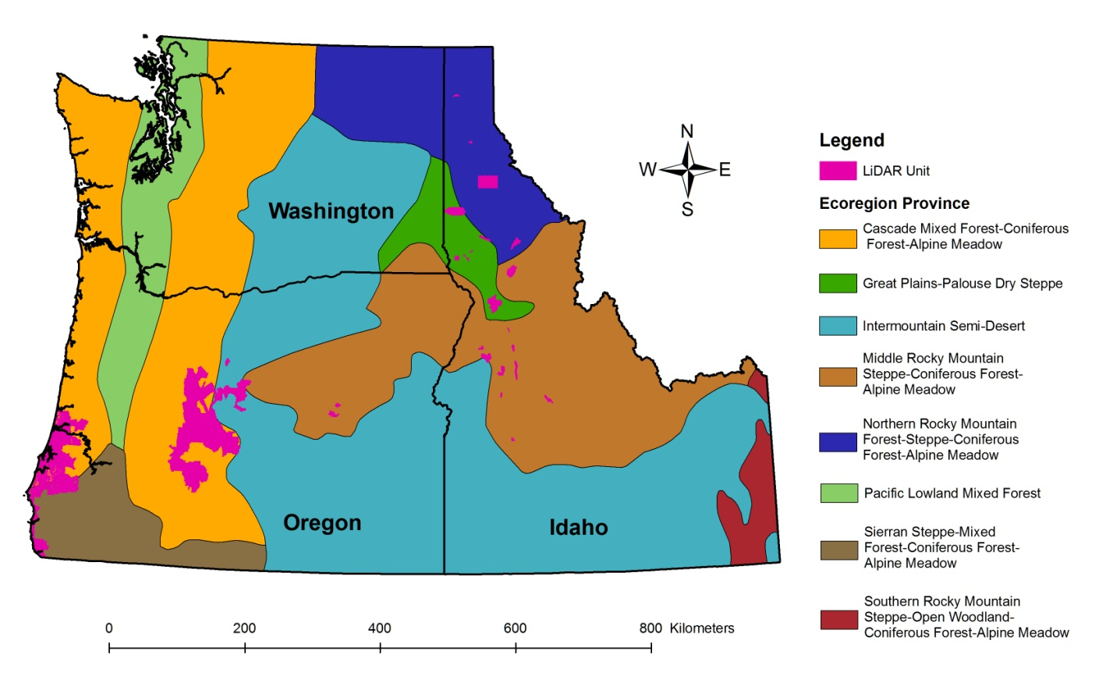
Generalized ecoregions in Pacific Northwest study region
Notes:
Map of PNW with generalized ecoregions and lidar project areas.

Slide 4
Transferability of reference plot biomass measures in a regional biomass carbon prediction model
Same
Province
Different
Province
Same
Province
Different
Province
Notes:
Predicted vs Observed contingency table of a regional imputation model predicting aboveground biomass across n=2037 field plots and n=17 reference landscapes with lidar. The 17 landscapes have been simplified to 4 generalized ecoregions here.

